Slide 1
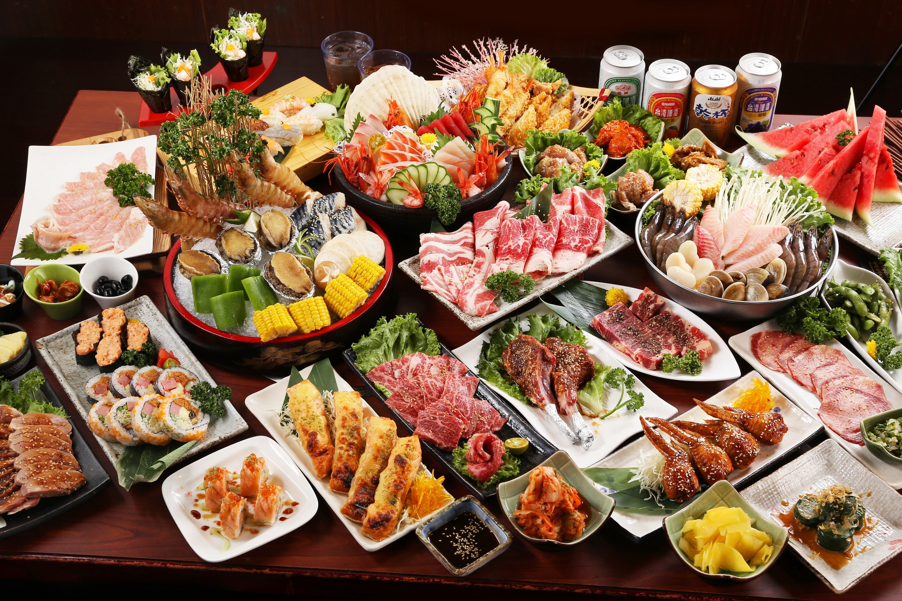
What comes to your mind when you hear the word «food»?

Slide 2
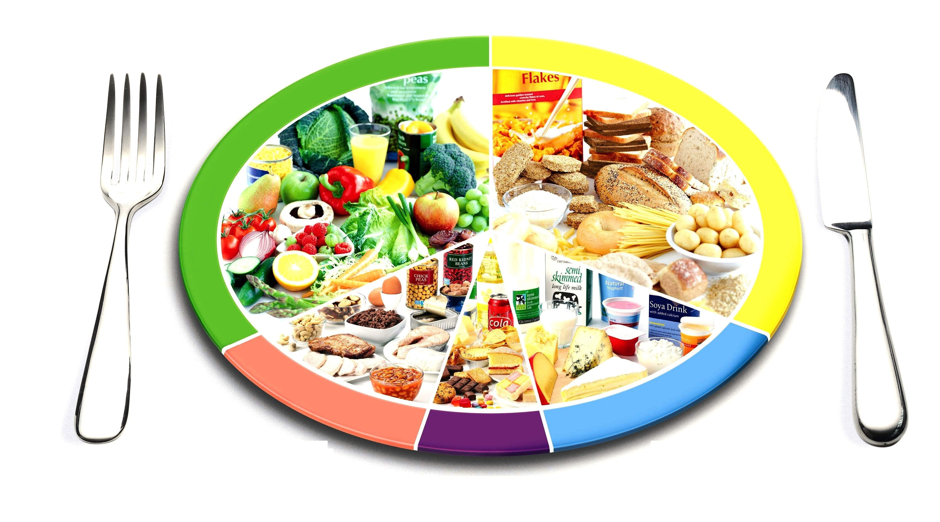
DIET
What does it mean?

Slide 3

Diet and teens health

Slide 4

Our main aim
To speak about healthy eating habits and dieting.

Slide 5

Watch a short video and answer the questions:
What we need to do to lose weight without harm for health?
What are the 7 steps for fast weight loss for teens? Name them, please.

Slide 6
give
back
(return sth you borrowed)
away
(give without waiting anything in return)
up
(stop doing sth)
off
(release a smell, light)

Slide 7
Fill in the gaps
1. He gave ____ all his books when he moved house.
2. The eggs were giving ____ a terrible smell.
3. She’s decided to give ____ smoking!
4. Did you give ____ that book to Diana?
5. Something in the fridge is giving ____ a horrible smell.
6. I’m thinking of giving ____ fatty foods.
7. I give ____ . What’s the answer?
8. Have you given ____ the book you borrowed from Zoe?
9. I’m giving ____ my recipe books to John. He needs them more than I do.

Slide 8

Keys:
1. gave away
2. giving off
3. give up
4. give back
5. giving off
6. giving up
7. give up
8. given back
9. giving away

Slide 9

Reflection
English
What have we done today?
What was difficult for you?
What new words have you learnt?
5

